Slide 1


SET
&
RELATION
Topic 2
TOPIC 2

Slide 2

ENGLISH | MALAY
Venn Diagram | Gambarajah Venn
Element | Unsur
Set | Set
Complement of Set | Set pelengkap
Empty set | Set kosong
Equal set | Set sama
Universal set | Set semesta
Subset | Subset
Set notation | Tatanda set
Terms in Set

Slide 3

What is Set ?
CAR
ROCKET
SAMPAN
LORRY
AEROPLANE
BOAT
SHIP
VAN
FERRY
HELICOPTER
BUS
HOT AIR BALLON
Classify the objects in the list above as land , water and air transportation

Slide 4

Land | Water | Air
the objects which have common characteristics
will be classified into the same group.
Each of these groups is known as set

Slide 5
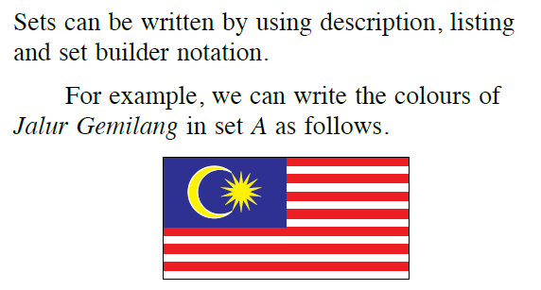
How to describe sets?

Slide 6
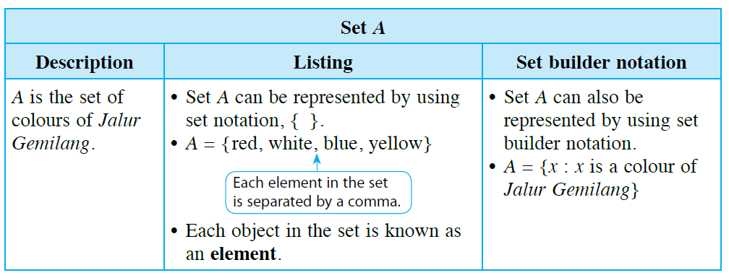

Slide 7
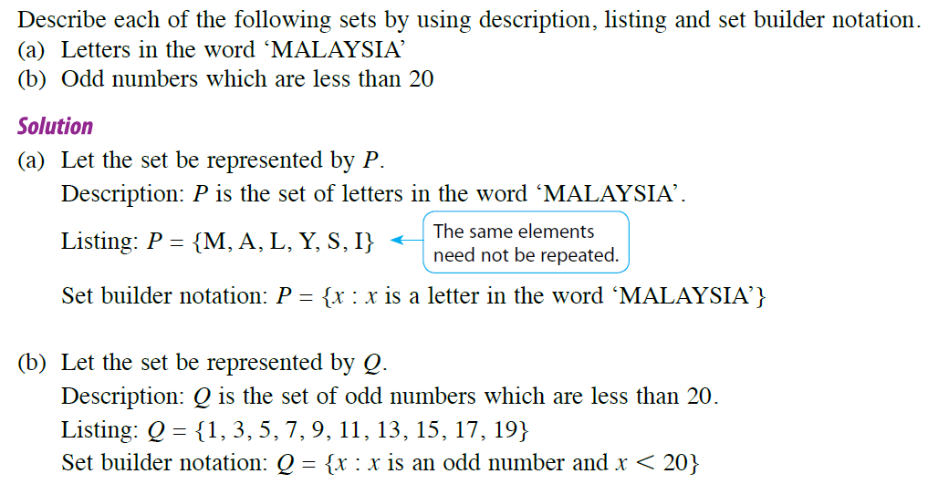
Example

Slide 8



Empty set
There is no month with 32 days
State the month with 32 days

Slide 9

If M represent the set of month with 32 days, then set M does not contain any element and is known as an empty set
Practice 1
Determine whether each of the following statements is TRUE or FALSE
If P = { odd numbers which are divisible by 2} , then P= Ø
If Q = { number of days in a week which are even numbers }, then Q=Ø

Slide 10
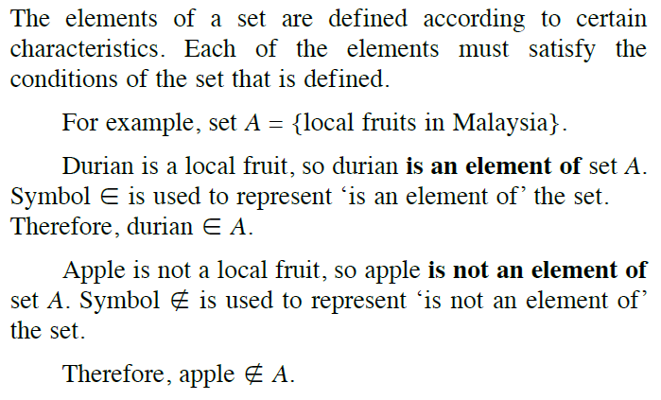

Element of set

Slide 11
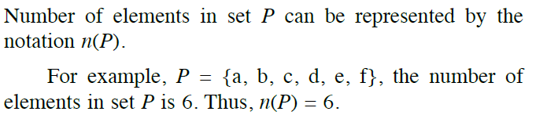
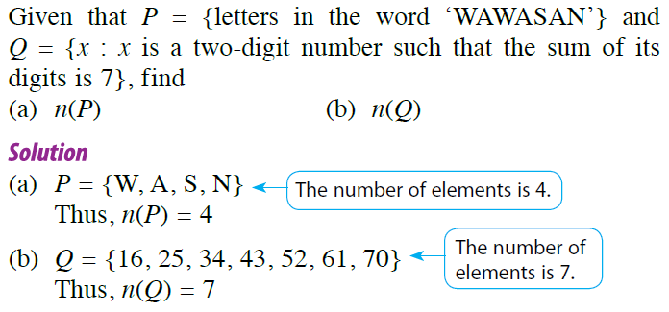
Determine number of element of a set
Example

Slide 12
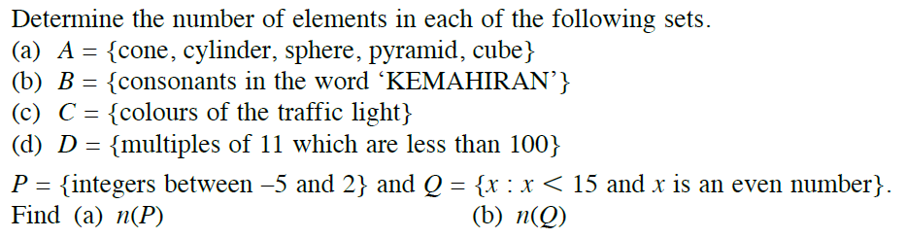

Practise 2

Slide 13
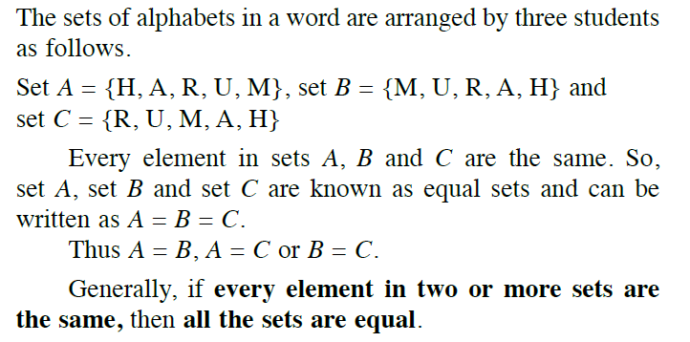

Equality of a set

Slide 14
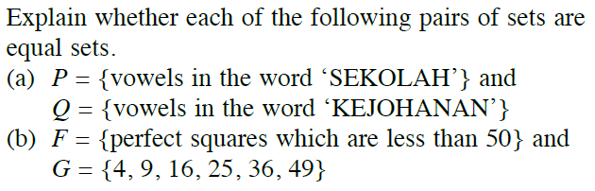
Example
Or not equal
J = { consonants in the word ‘ARWAH’} and
K = { consonants in the word ‘ WARKAH’ }

Slide 15

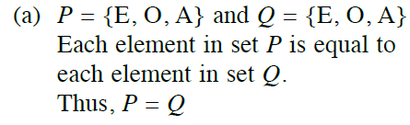
Solution
J = { R,W,H} and K = { W,R,K,H}
Each element in set J is not equal to element in K.
Thus , J ≠ K

Slide 16
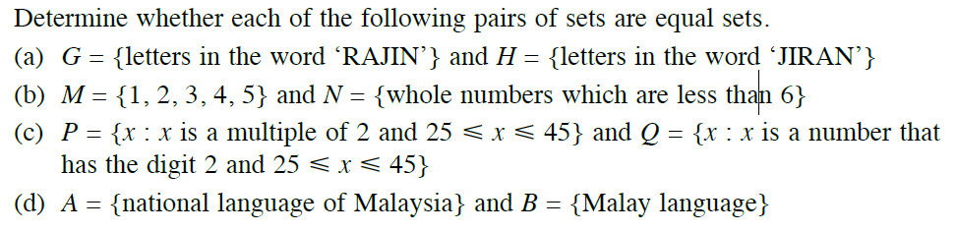

Practice 3

Slide 17
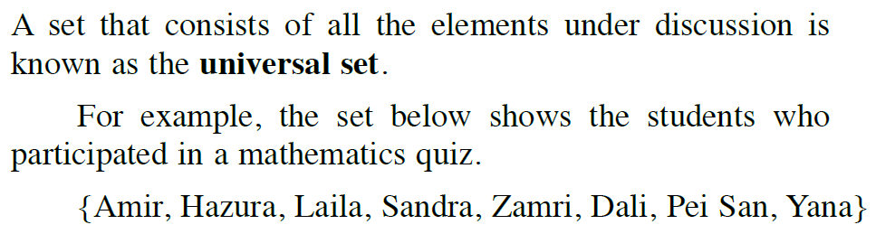

Universal set & Compliment of a set

Slide 18
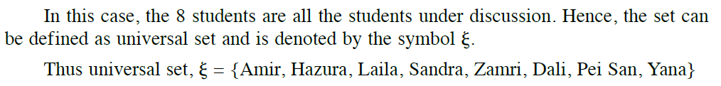
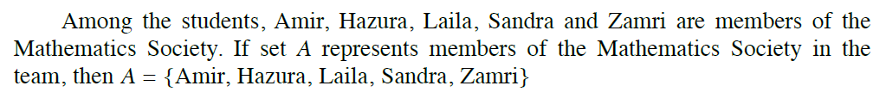
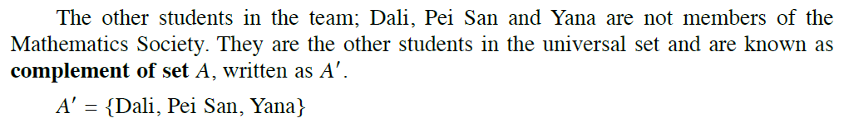
Cont..

Slide 19
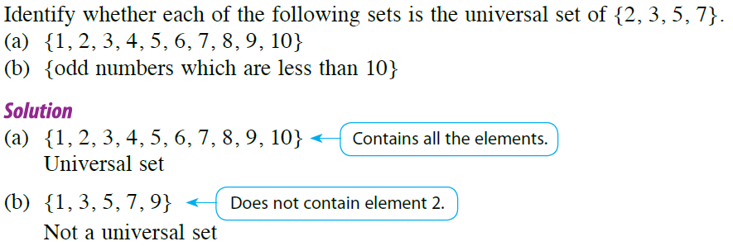
Example

Slide 20
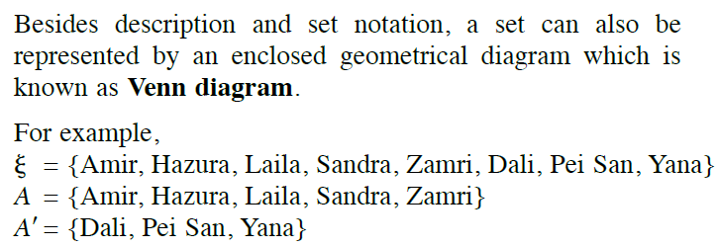
Venn Diagram

Slide 21
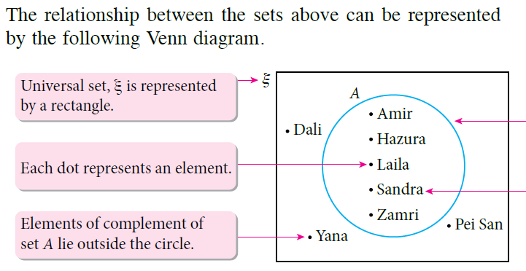
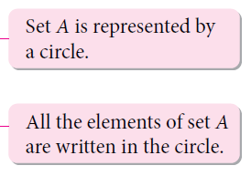

Slide 22
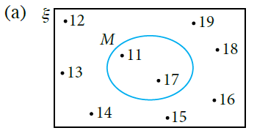
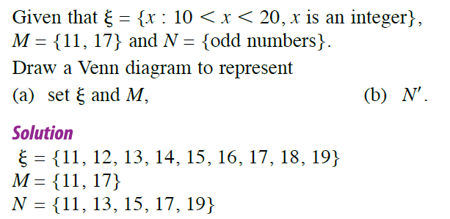
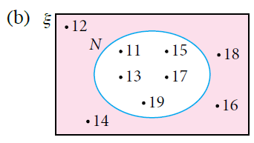
Example

Slide 23

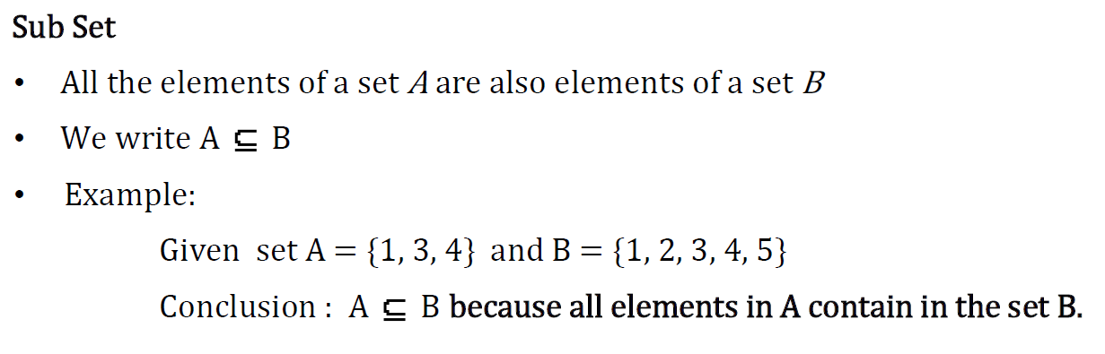
Subset

Slide 24
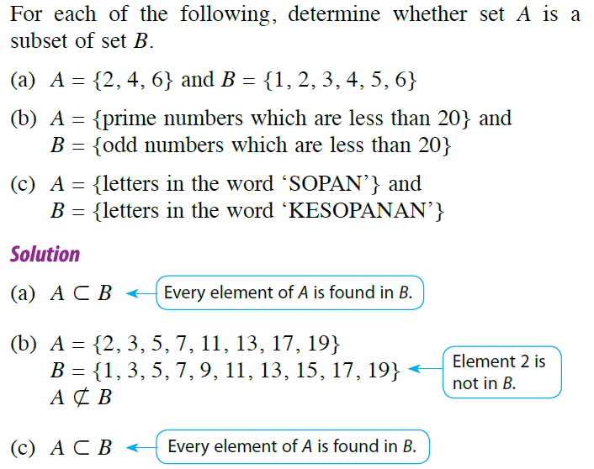
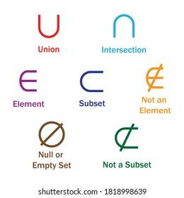
Subset

Slide 25
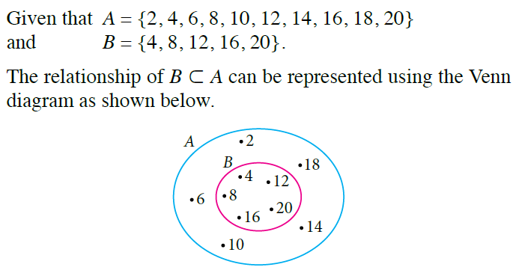
Represent subset using Venn Diagram

Slide 26
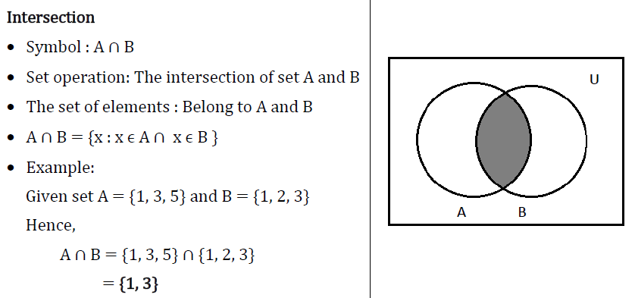
Set operation

Slide 27
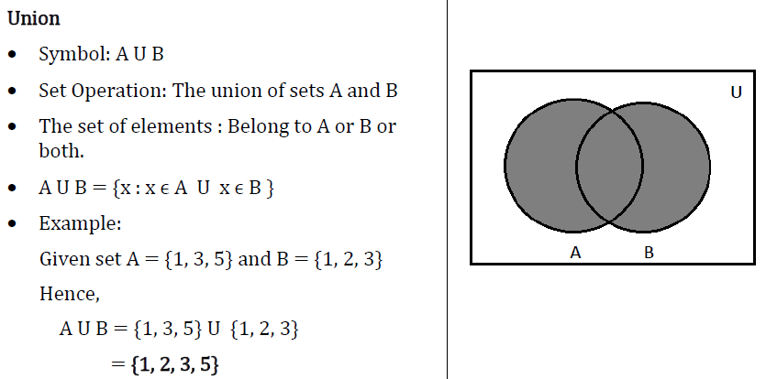
Set operation

Slide 28
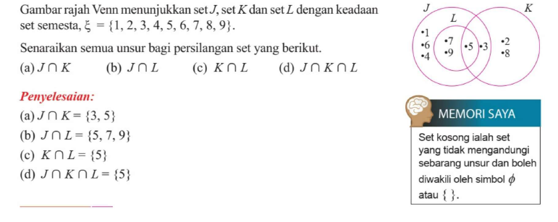
Contoh

Slide 29
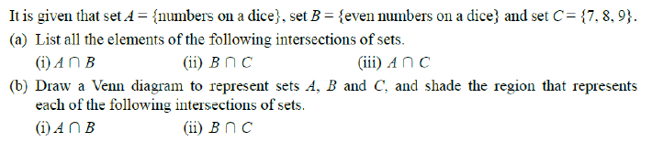
Practice 4

Slide 30
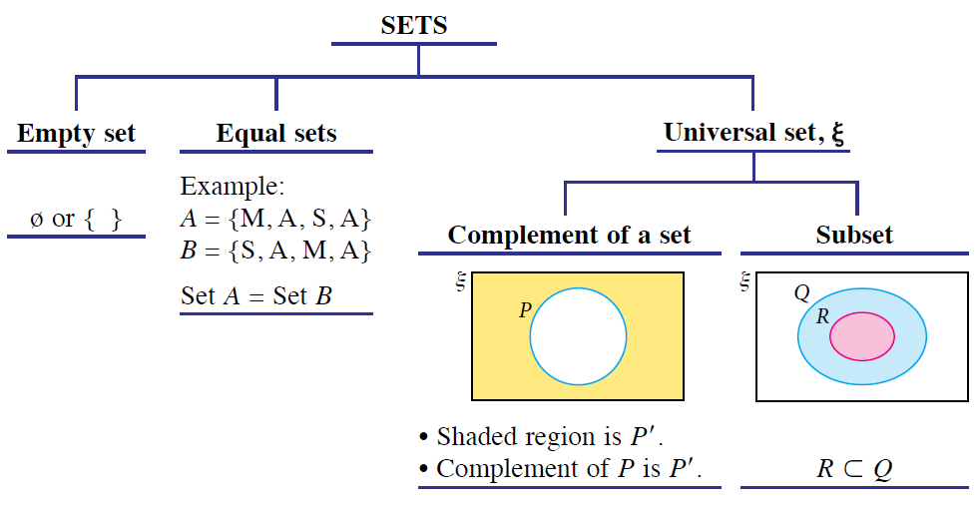
Summary

Slide 31
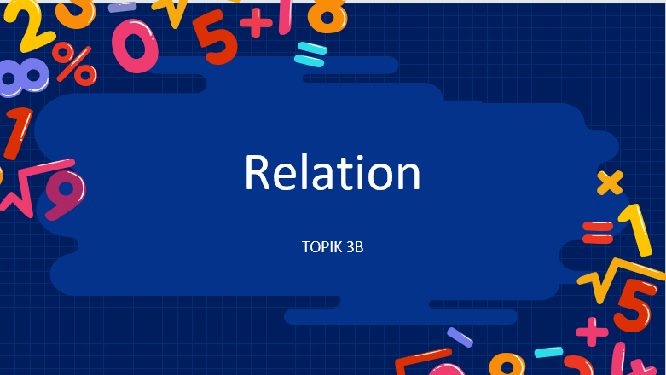
Relation

Slide 32
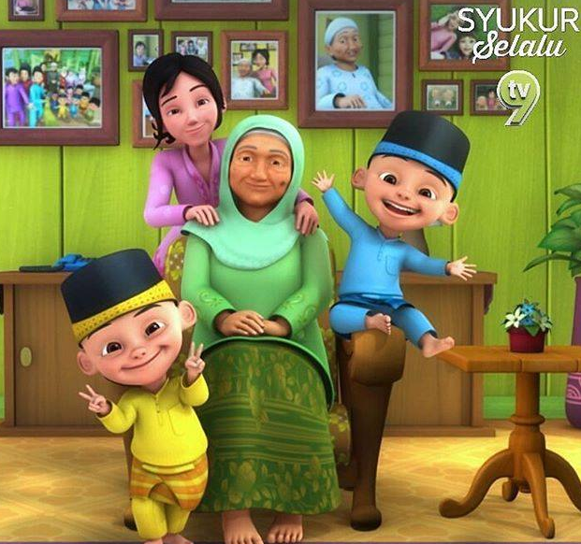
Relation (Hubungan/hubungkait)
Sister
Twin
Twin
Grandmother

Slide 33
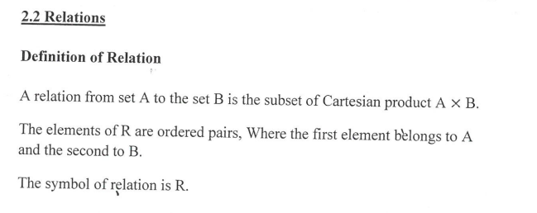
Relation in a set

Slide 34
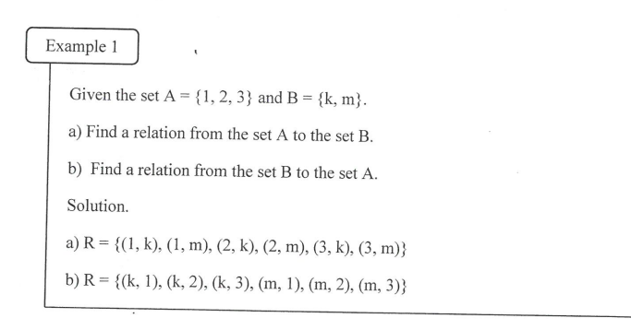
Relation
.
.
.
1
.
k
2
m
.
3

Slide 35
Exercise
Given the set A = {1, 2, 3} and B = {2,4,6}.
Find a relation from the set A to the set B.
Find a relation from the set B to the set A.

Slide 36
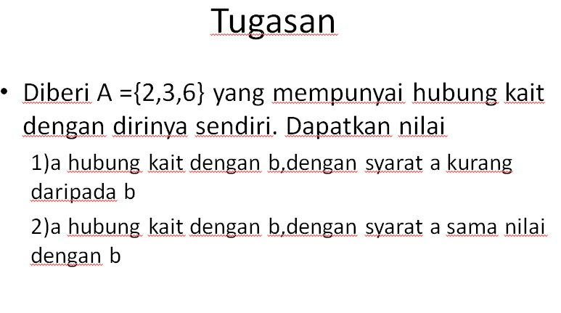

Slide 37
Solution
.
.
2
2
.
.
3
3
.
.
6
6

Slide 38
Exercise
List the ordered pairs in the relation R from
A = {0, 1, 2, 3, 4} to B = {0, 1, 2, 3}, where
(a, b) ∈ R if and only if :
a) a = b
b) a > b

Slide 39
Type of relation
Reflexive
Symmetric
Transitive
Antisymmetric

Slide 40
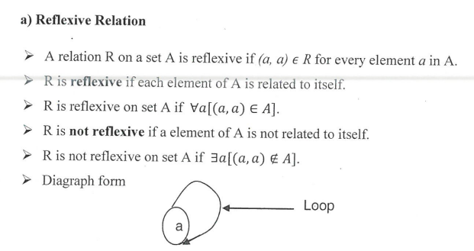

Slide 41
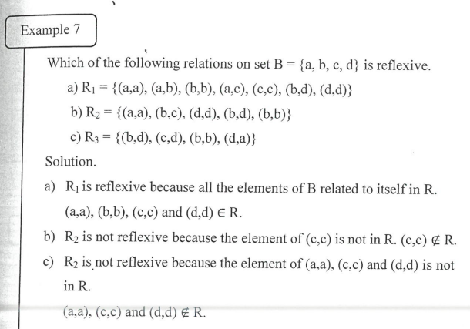

Slide 42
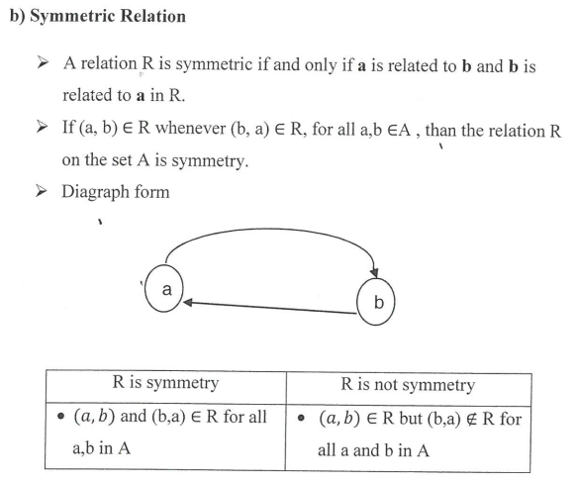
Symmetric

Slide 43
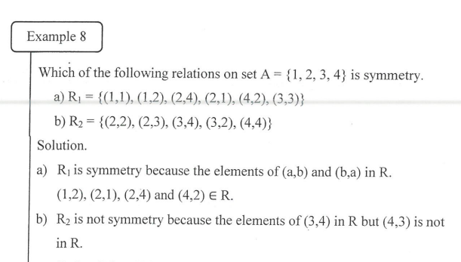

Slide 44
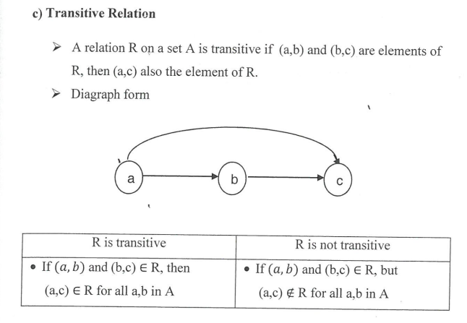

Slide 45
ANTISYMMETRIC
A relation R on the set A such that for all a, b ∈ A, if (a, b) ∈ R and (b, a) ∈ R, then a = b is called antisymmetric.
A relation is antisymmetric if and only if there are no pairs of distinct elements a and b with a related to b and b related to a.
The term symmetric and antisymmetric are not opposites, because a relation can have both of these properties or may lack of them.
Example 12: Consider the following relations on {1, 2, 3, 4}:
  R1 = {(1,1), (1,2), (2,1), (2,2), (3,4), (4,1), (4,4)}
  R2 = {(1,1), (1,2), (2,1)}
  R3 = {(1,1), (1,2), (1,4), (2,1), (2,2), (3,3), (4,1), (4,4)}
  R4 = {(2,1), (3,1), (3,2), (4,1), (4,2), (4,3)}
  R5 = {(1,1), (1,2), (1,3), (1,4), (2,2), (2,3), (2,4), (3,3), (3,4), (4,4)}
  R6 = {(3,4)}.
Which of these relations are antisymmetric?

Slide 46
ANTISYMMETRIC
R4, R5 and R6 are all antisymmetric. For each of these relations there is no pair of elements a and b with a ≠ b such that (a, b) and (b, a) belong to the relation.
Digraph: A relation is antisymmetric if and only if there are never two edges in opposite directions between distinct vertices.

Slide 47


