Slide 1
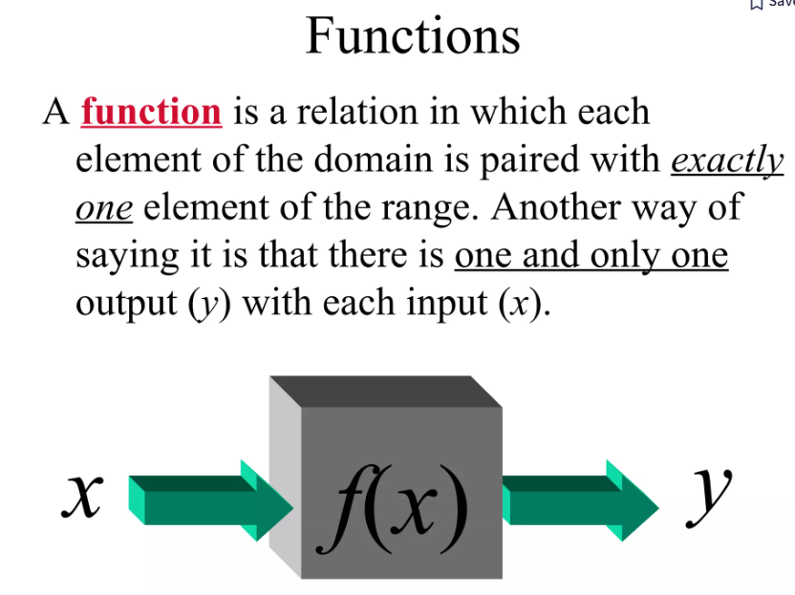
TOPIC 3 : FUNCTION

Slide 2
Notation
f(x) = x²
Function name
output
input

Slide 3
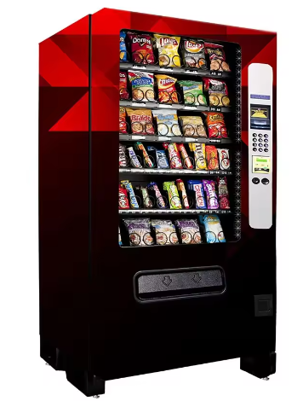
Example of real life
Vending machine
Input
Function
Output

Slide 4
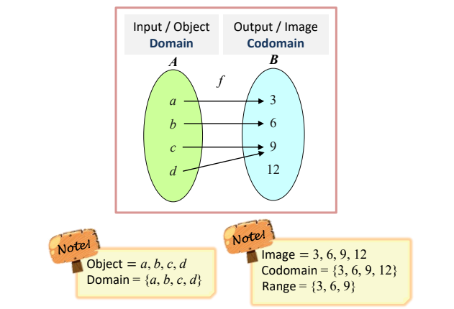
Basic concept of function

Slide 5
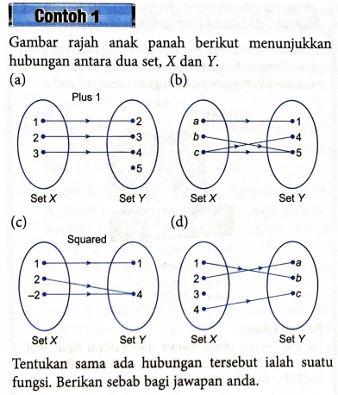
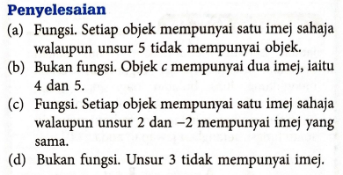
Identify characteristic of function

Slide 6
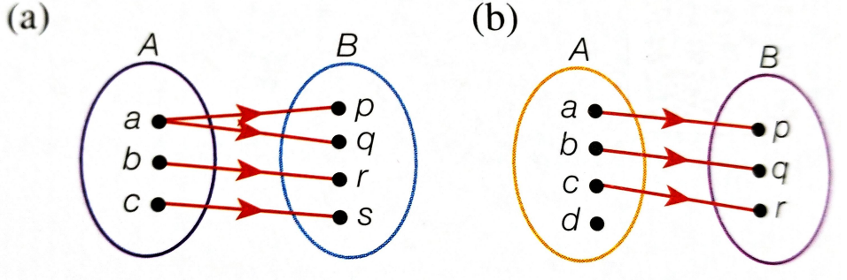
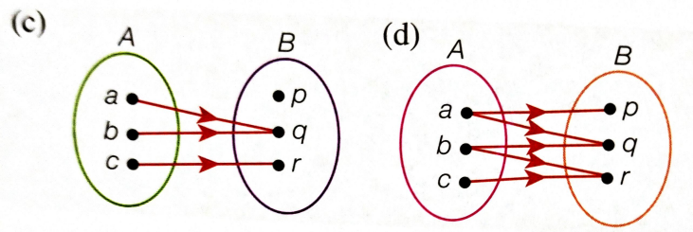
Exercise
1) Determine whether each of the following relations is a function. Explain your answers.

Slide 7
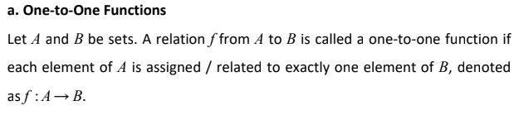
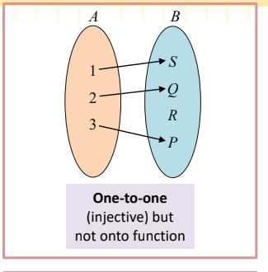
Properties of function

Slide 8
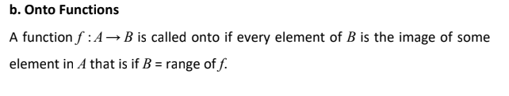
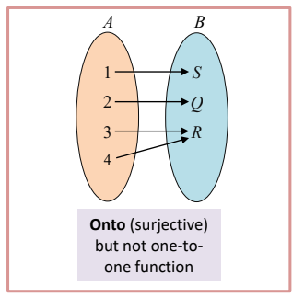
Properties of function

Slide 9
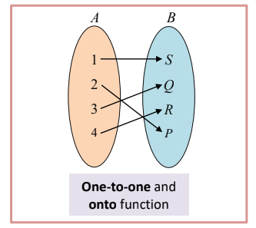
Properties of function
Onto function and one-to-one function

Slide 10
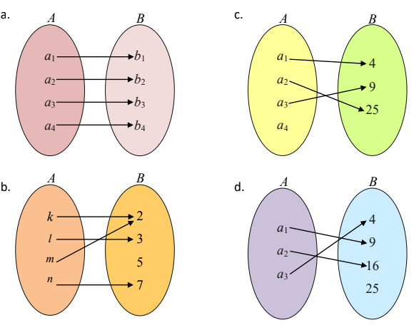
Exercise

Slide 11
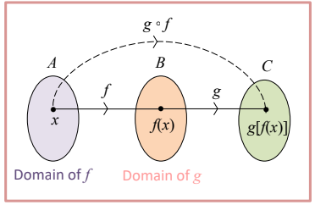
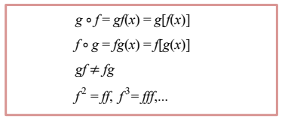
Composite function (fungsi gubahan)
Composite function is a function of another function's values.
The definition of composite function:

Slide 12
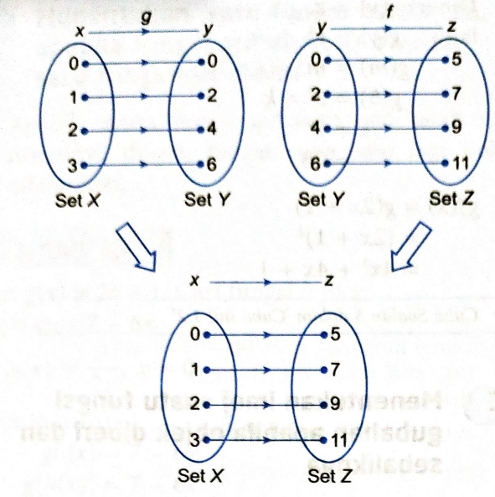
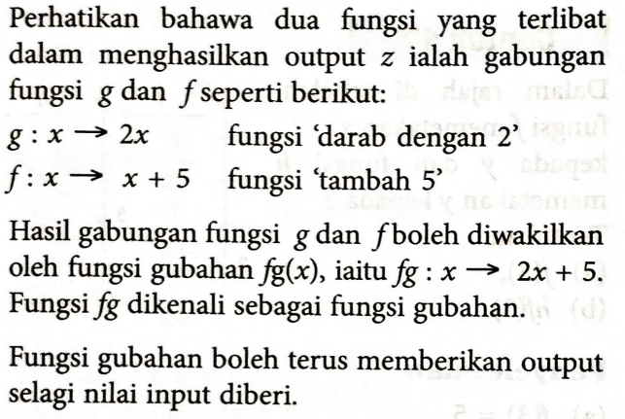
Fungsi Gubahan

Slide 13
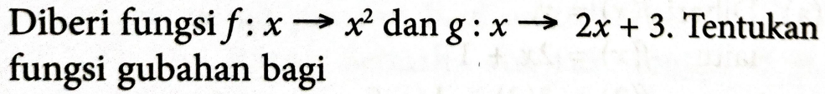
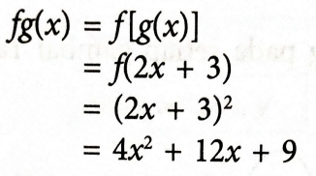
Contoh
a) fg
solution

Slide 14
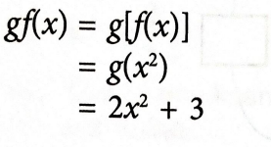
Contoh
b) gf
solution

Slide 15
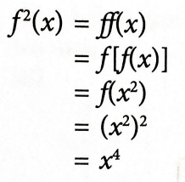
Contoh
c) f²
solution

Slide 16
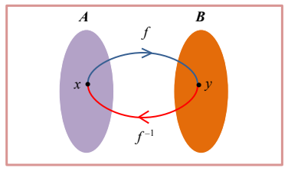
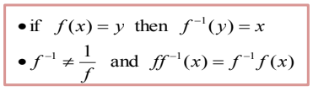
Inverse Function (Fungsi songsang)

Slide 17
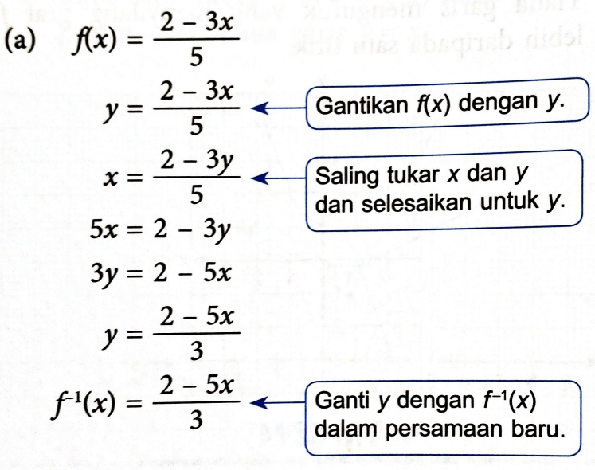
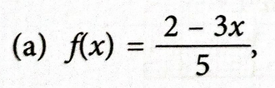
Contoh
Tentukan fungsi songsang bagi

Slide 18
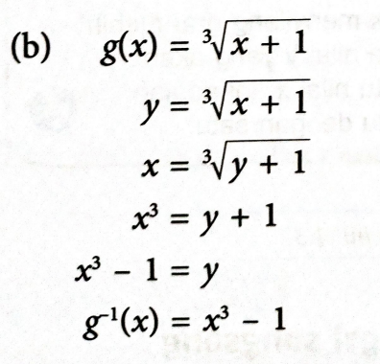

Contoh
Tentukan fungsi songsang bagi

