Slide 1
TOPIC 4 GRAPH
SFC10383 BASIC MATHEMATICS

Slide 2
In this topic, we will learn:
  Identify the graph terminology.
  Describe the properties of graph.
    Simple Graph
    Digraph
    Weighted Graph
    Connected Graph
  Identify the types of Simple Graph.
    Discrete Graph
    Complete Graph
    Linear Graph
    Bipartite Graph
  Illustrate Paths, Cycles, Planarity, and Isomorphic in Graph.
  Algorithm in Graph.

Slide 3
Graf Definition
A graph in mathematics is a fundamental concept used to represent relationships between objects.
It consists of vertices (nodes) connected by edges (lines or arcs). Vertices represent entities, while edges depict the connections between these entities.
In more technical terms, a graph is defined as G(E, V), where E represents the set of edges and V represents the set of vertices.
Graphs can be directed or undirected and are utilized in various mathematical applications, including computer science to model computational flow.

Slide 4
Definisi graf
Graf dalam matematik adalah konsep asas yang digunakan untuk mewakili hubungan antara objek. Ia terdiri daripada titik (nod) yang disambung oleh hujung (garis atau lengkung).
Titik mewakili entiti, manakala hujung menggambarkan hubungan antara entiti-entiti ini.
Dalam terma yang lebih teknikal, graf ditakrifkan sebagai G(E, V), di mana E mewakili set hujung dan V mewakili set titik.
Graf boleh menjadi berarah atau tidak berarah dan digunakan dalam pelbagai aplikasi matematik, termasuk sains komputer untuk memodelkan aliran komputasi.

Slide 5
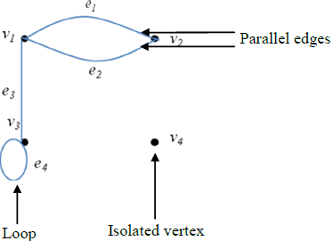
GRAPH TERMINOLOGY
A graph G = (V, E) consists of a nonempty set of vertices (nodes) and a set of edges (arcs).
The order of graph is the number of vertices.
The size of graph is the number of edges.
Each edge has either one or two vertices associated with it, called its endpoints.
An edge with just one endpoint is called a loop.
If a vertex v is an endpoint of edge e, we say they are incident.
If two vertices in a graph are connected by an edge, we say the vertices are adjacent.
Two distinct edges with the same set of endpoints are called as parallel edges.
More than two edges with the same set of endpoints are called as multiple edges.
A vertex on which no edges are incident is called isolated.

Slide 6
ISTILAH DI DALAM GRAF
Graf G = (V, E) terdiri daripada satu set vertex (bucu atau nod) dan satu set sisi (lengkungan) yang tidak kosong.
Susunan graf adalah mengikut bilangan bucu. Saiz graf ialah mengikut bilangan sisi.
Setiap sisi mempunyai satu atau dua bucu yang berkaitan dengannya, yang dipanggil titik akhir.
Sebuah sisi dengan hanya satu titik akhir dipanggil gelung.
Sekiranya bucu v adalah titik akhir tepi e, dikenali sebagai insiden.
Jika dua bucu dalam graf disambungkan oleh sisi, ia dikenali sebagai bucu bersebelahan (adjacent).
Dua sisi yang berbeza dengan set titik akhir yang sama dipanggil sebagai sisi selari.
Lebih daripada dua sisi dengan set titik akhir yang sama dipanggil sebagai pelbagai sisi.
Sebuah bucu di mana tiada tepi yang berlaku dipanggil bucu terpencil.

Slide 7
The Concept of Degree
The degree of a vertex in an undirected graph is the number of edges that are incident on v, except the loop at a vertex counted twice.
The degree of v is denoted by deg(v).
A vertex of degree zero is called isolated.
A vertex is pendant if and only if it has degree one.

Slide 8
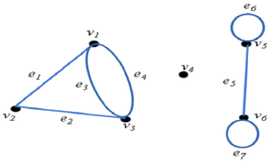
EXAMPLE 1
Consider the following graph:
a)Find
  all loops
  all parallel edges
  all isolated vertices
  all the edges that incident with vertex v₃.
  all the vertices that adjacent with v₁.
b)Find the degree of each vertex.
c)Find the order and the size of graph.
e₆ & e₇
e₃ & e₄
v₄
e₂, e₃, e₄
v₂, v₃
deg(v₁)=3, deg(v₂)=2
deg(v₃)=3, deg(v₄)=0
deg(v₅)=3, deg(v₆)=3
The order of graph is 6 and the size of graph is 7.

Slide 9
The Properties of Graph
(Sifat atau ciri-ciri graf)
In this lesson, we will learn some properties of graph, there are:
a) Simple graph – graf mudah
b) Directed graph (Digraph) – graf terarah
c) Weighted graph – graf berpemberat
d) Connected graph – graf bersambung

Slide 10
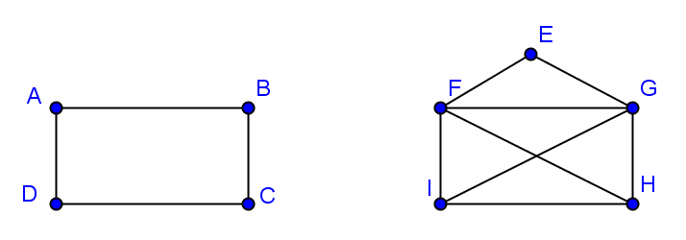
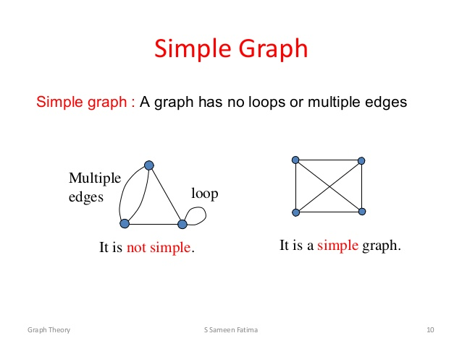
SIMPLE GRAPH – GRAF MUDAH
A simple graph is a graph without any loop and parallel edges.
Graf mudah adalah graf tanpa gelung dan tepi selari.
Examples of simple graph:
Examples of not simple graph:

Slide 11
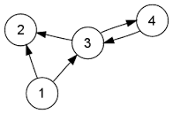
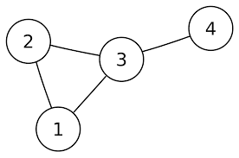
DIRECTED GRAPH (DIGRAPH)
GRAF TERARAH
A directed graph (V, E) consists of a nonempty set of vertices V and a set of directed edges E.
Graf terarah (V, E) mengandungi beberapa vertex (V) dan sisi tepi ,edge (E) yang mempunyai arah /anak panah.
Each directed edge is associated with an ordered pair of vertices (u, v) and said as start at u and end at v.
Setiap sisi tepi yang mempunyai arah akan dikaitkan dengan bucu (vertex) mengikut susunan. contohnya mula di u dan berakhir di v.
Example of directed graph:
Example of undirected graph:

Slide 12
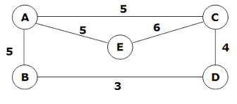
WEIGHTED GRAPH
GRAF BERPEMBERAT
Graph that have a number assigned to each edge are called weighted graph.
Graf yang mempunyai pemberat pada sisi tepi (edge)
Example of weighted graph:

Slide 13
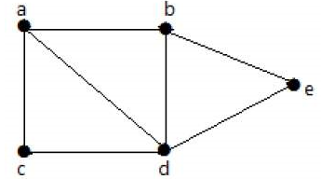
CONNECTED GRAPH
GRAF BERSAMBUNG
A graph is said to be connected if there is a path between every pair of vertex.
Graf bersambung merupakan graf yang mempunyai laluan antara pasangan vertex / bucu
From every vertex to any other vertex, there should be some path to traverse.
Dari satu bucu ke bucu lain, perlu ada beberapa jalan untuk melintasi di antaranya
Example of connected graph:
it is possible to travel from one vertex to any other vertex.
For example, one can traverse from vertex ‘a’ to vertex ‘e’ using the path ‘a-b-e’.

Slide 14
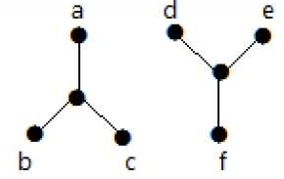
DISCONNECTED GRAPH
Example of disconnected graph:
traversing from vertex ‘a’ to vertex ‘f’ is not possible because there is no path between them directly or indirectly.
Hence it is a disconnected graph.

Slide 15
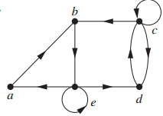
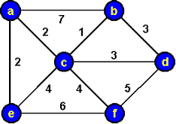
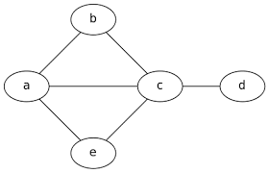
EXERCISE1
State the type of the following graphs:
a)
b)
c)
Directed graph
Weighted graph
Simple graph

Slide 16
Different Types of Simple Graphs
(Jenis-jenis graf mudah)
We will introduce several classes of simple graphs, there are:
a) Discrete graph – graf diskret
b) Complete graph – graf lengkap
c) Linear Graph – graf garis atau graf linear
d) Bipartite graph – graf bipartit

Slide 17
DISCRETE GRAPH
GRAF DISKRET
The discrete graph on n vertices, denoted by Dn, where n must be a positive integer, is a simple graph that composed of isolated vertex (with no edge) only.
Graf diskret dengan bilangan bucu,n diwakili oleh Dn di mana n adalah nombor positif. Graf diskret merupakan graf yang terkandung oleh bucu terpinggir (isolated vertex) yang tiada sisi tepi langsung.
Example: The complete graphs D₂ and D₅ can be drawn as follows:-
D₂
D₅

Slide 18

COMPLETE GRAPH
The complete graph on n vertices, denoted by Kn, where n must be a positive integer, is a simple graph that contain exactly one edge between each pair of distinct vertices.
Example: The complete graphs K₁, K₂, K₃, K₄ and K₅ can be drawn as follows:-

Slide 19
EXAMPLE OF COMPLETE GRAPH, K₆

Slide 20
LINEAR GRAPH
The linear graph on n vertices, denoted by Ln, where n must be a positive integer, is a simple graph that every vertices adjacent with at most two vertices and form a line.
Example: The complete graphs L₃ and L₅ can be drawn as follows:-
L₃
L₅
or
Not a L_{5.}

Slide 21
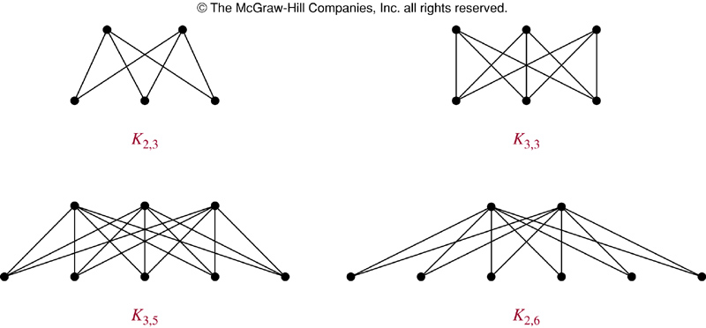
BIPARTITE GRAPH
A simple graph G is called bipartite if its vertex set V can be partitioned into two disjoint sets V1 and V2 such that every edge in the graph connects a vertex in V1 and a vertex in V2. It cannot be an edge in G connects either two vertices in same vertex set.
The complete bipartite graph on (m, n) vertices, denoted Km, n is the graph that has its vertex set partitioned into two subsets of m and n vertices, respectively.
Example of complete bipartite graph:

Slide 22
EXAMPLE OF COMPLETE BIPARTITE GRAPH, K_{3,4}

Slide 23
EXERCISE 2
Draw a simple graph with six vertices and nine edges.
Draw a complete graph, K₇
Draw a complete bipartite graph, K_{5,4}
Draw a discrete graph, D₇
Draw a linear graph, L₆

Slide 24
PATH AND CYCLE (CIRCUIT)
Path is a sequence of edges that begins at a vertex of a graph and travels from vertex to vertex along edges of the graph.
The path is called as cycle or circuit if it begins and ends at the same vertex.
Path or circuit with length n is a sequence with n edges.
A path or circuit is simple if it does not contain the same edge more than once.
Example: construct a path with length two, a path with length four, a circuit with length three, and a circuit with length four from the graph below.
Path with length 2: a,b,e or c,d,b and etc.
Path with length 4: a,c,d,e,b or e,b,a,d,c and etc.
Circuit with length 3: a,c,d,a or b,e,d,b and etc.
Circuit with length 4: c,d,b,a,c or b,e,d,a,b and etc.

Slide 25
PLANAR GRAPH
A graph is called planar if it can be drawn in the plane without any edges crossing.
A graph may be planar even it is usually drawn with crossings, because it may be possible to draw it in a different way without crossings.
The corollaries to show whether a graph is planar:-
  If G is a connected planar simple graph with e edges and v vertices, where v≥3, then e ≤ 3v – 6.
  If G is a connected planar simple graph, then G has a vertex of degree not exceeding five.
  If G is a connected planar simple graph with e edges and v vertices, where v≥3 and no circuits of length three, then e ≤ 2v – 4.

Slide 26
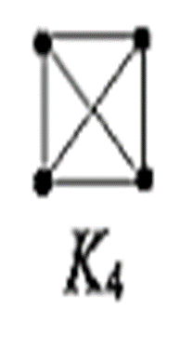
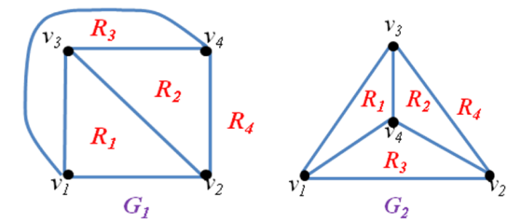
EXAMPLE 1
Determine whether K₄ is planar graph.
Since K₄ has 4 vertices, 6 edges, and circuit with length three, hence we using corollary 1 to determine K₄ is planar.
Corollary 1: 6 ≤ 3(4) – 6
  6 ≤ 6 (satisfy)
  Hence, K₄ is planar graph.
  G₁ and G₂ all are planar of K₄. This means planar graph can be drawn in different ways which satisfy all the identities of K₄.

Slide 27
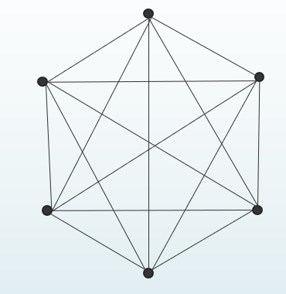
EXAMPLE 2
Determine whether K₆ is planar graph.
Since K₆ has 6 vertices, 15 edges, and circuit with length three, hence we using corollary 1 to determine whether K₆ is planar.
Corollary 1: 15 ≤ 3(6) – 6
  15 ≤ 12 (not satisfy)
  Hence, K₆ is not planar graph.
  Since K₆ is not planar means that there must has a crossing edges however we try to draw it in different ways.

Slide 28
EXAMPLE 3
Determine whether K_{2,3} is planar graph.
Since K_{2,3} has 5 vertices, 6 edges, and no circuit with length three, hence we using corollary 3 to determine whether K_{2,3} is planar.
Corollary 1: 6 ≤ 2(5) – 4
  6 ≤ 6 (satisfy)
  Hence, K_{2,3} is planar graph.

Slide 29
EXERCISE 3
Determine whether the following graphs are planar graph.
  K₅
  K_{2,4}
  K_{3,3}

Slide 30
ISOMORPHIC GRAPHS
The simple graphs G1 and G2 are isomorphic if there is a bijective function (one-to-one and onto) f from V1 to V2 with the property that a and b are adjacent in G1 if and only if f(a) and f(b) are adjacent in G2, for all a and b in V1.
A property preserved by isomorphic graphs are:-
  Must have the same number of vertices.
  Must have the same number of edges.
  The degrees of the vertices must be the same.
However, the properties only can be used to show two graphs are not isomorphic, but can not show that two graphs are isomorphic.
So, function mapping is most part to show whether the graphs are isomorphic or not.
If the function is bijective, then the graphs are isomorphic.

Slide 31
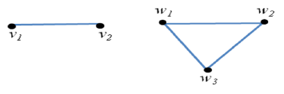
EXAMPLE 1
Determine whether the given pair of the graphs below are isomorphic or not. Explain your answer.
 | Graph 1 | Graph 2
The number of vertices | 2 | 3
The number of edges | 1 | 3
The degree of each vertex | deg(v1) = 1 deg(v2) = 1 | deg(w1) = 2 deg(w2) = 2 deg(w3) = 2
Different
Different
Different
Since the number of vertices, the number of edges and the degree of each vertex are different, hence the graphs are not isomorphic.

Slide 32
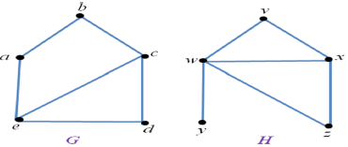
EXAMPLE 2
Determine whether the given pair of the graphs below are isomorphic or not. Explain your answer.
 | Graph G | Graph H
The number of vertices | 5 | 5
The number of edges | 6 | 6
The degree of each vertex | deg(a) = 2 deg(b) = 2 deg(c) = 3 deg(d) = 2 deg(e) = 3 | deg(v) = 2 deg(w) = 4 deg(x) = 3 deg(y) = 1 deg(z) = 2
Same
Same
Different
Even the number of vertices and the number of edges are same, but since the degree of each vertex are different. Therefore, the graphs are not isomorphic.

Slide 33
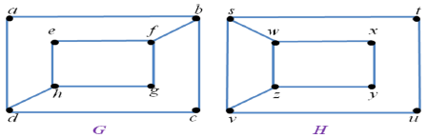
EXAMPLE 3
Determine whether the following pair of the graphs are isomorphic or not. Explain your answer.
 | Graph G | Graph H
The number of vertices | 8 | 8
The number of edges | 10 | 10
The degree of each vertex | deg(a) = 2 deg(b) = 3 deg(c) = 2 deg(d) = 3 deg(e) = 2 deg(f) = 3 deg(g) =2 deg(h) =3 | deg(s) = 3 deg(t) = 2 deg(u) = 2 deg(v) = 3 deg(w) = 3 deg(x) = 2 deg(y) =2 deg(z) =3
Same
Same
Same
Even the number of vertices, the number of edges and the degree of each vertex are same, but these are not sufficient to prove that the graphs are isomorphic. Now, we need to use function mapping to determine whether the graphs are isomorphic or not.

Slide 34
Example 3
Determine whether the following pair of the graphs are isomorphic or not. Explain your answer.
 | Graph G | Graph H
Function mapping | deg(a) = 2 deg(b) = 3 deg(c) = 2 deg(d) = 3 deg(e) = 2 deg(f) = 3 deg(g) =2 deg(h) =3 | deg(s) = 3 deg(t) = 2 deg(u) = 2 deg(v) = 3 deg(w) = 3 deg(x) = 2 deg(y) =2 deg(z) =3
We should look for the vertices in graph G which corresponding to the vertices in graph H.
However, there are no vertices in H correspond with the vertices in G.
To see this, deg(a) = 2 and adjacent with other two vertices with degree three. In H, also have vertices with degree two but all of them are not adjacent with other two vertices with degree three.
Therefore, G and H are not isomorphic.

Slide 35
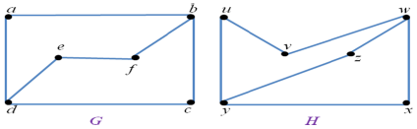
EXAMPLE 4
Determine whether the following pair of the graphs are isomorphic or not. Explain your answer.
 | Graph G | Graph H
The number of vertices | 6 | 6
The number of edges | 7 | 7
The degree of each vertex | deg(a) = 2 deg(b) = 3 deg(c) = 2 deg(d) = 3 deg(e) = 2 deg(f) = 2 | deg(u) = 2 deg(v) = 2 deg(w) = 3 deg(x) = 2 deg(y) =3 deg(z) =2
Same
Same
Same
Even the number of vertices, the number of edges and the degree of each vertex are same, but these are not sufficient to prove that the graphs are isomorphic. Now, we need to use function mapping to determine whether the graphs are isomorphic or not.

Slide 36
Example 4
Determine whether the following pair of the graphs are isomorphic or not. Explain your answer.
 | Graph G | Graph H
Function mapping | deg(a) = 2 deg(b) = 3 deg(c) = 2 deg(d) = 3 deg(e) = 2 deg(f) = 2 | deg(u) = 2 deg(v) = 2 deg(w) = 3 deg(x) = 2 deg(y) =3 deg(z) =2
We should look for the vertices in graph G which corresponding to the vertices in graph H.
We can found that f(a) = x, f(b) = w, f(c) = z, f(d) = y, f(e) = u and f(f) = v. This is a one-to-one and onto function from the vertices of G to the vertices of H.
Hence, the graph G and the graph H are isomorphic.

Slide 37
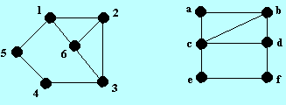
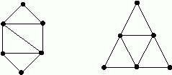
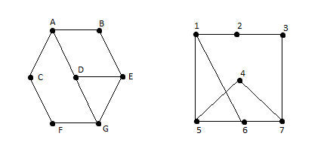
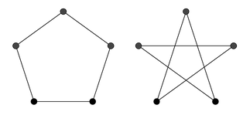
EXERCISE 4
Determine whether the following pairs of graphs are isomorphic or not. Give your reasons.
a) c)
b) d)

Slide 38
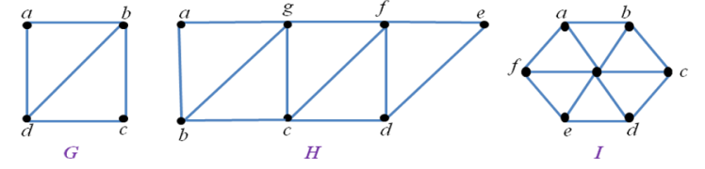
EULER PATH
A Euler path is a path that starting and ending at the difference vertices and visits each edge only once.
Theorem 1: A connected graph has a Euler path but not a Euler circuit if and only if it has exactly two vertices of odd degree.
Example: Which graphs shown below have a Euler path?
G contain exactly two vertices of odd degree, there are b and d. Hence, it has a Euler path that must have b and d as its endpoints. The Euler path is d, a, b, c, d, b.
H also has exactly two vertices of odd degree, there are b and d. Hence, it has n Euler path that must have b and d as its endpoints. The Euler path is b, a, g, f, e, d, c, g, b, c, f, d.
I has no Euler path because it has six vertices of odd degree.

Slide 39
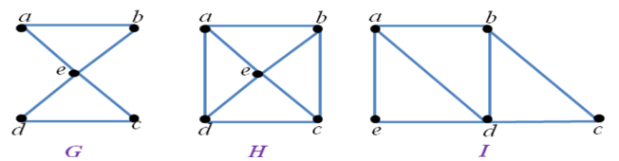
EULER CIRCUIT
A Euler circuit is a circuit that starting and ending at the same vertex and visits each edge only once.
Theorem 2: A connected graph with at least two vertices has a Euler circuit if and only if each of its vertices has even degree.
Example: Which of the undirected graphs in below have a Euler circuit? Of those that do not, which have a Euler path?
G has a Euler circuit because all vertices have even degree. For example, a, b, e, d, c, e, a.
H has neither Euler circuit nor Euler path because the graph has four vertices of odd degree.
I has Euler path but not Euler circuit because has two vertices of odd degree, there are a and b. The Euler path is a, e, d, a, b, d, c, b.

Slide 40
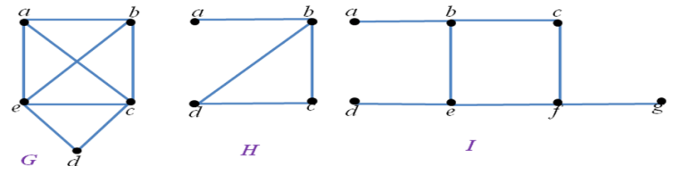
HAMILTON PATH AND HAMILTON CIRCUIT
Hamilton path is a path that starting and ending at the difference vertices and passes through every vertex exactly once.
Hamilton circuit is a circuit that starting and ending at the same vertex and passes through every vertex exactly once.
A graph with a vertex of degree one cannot have a Hamilton circuit.
Example: Which of the simple graph below have a Hamilton circuit or, if not, a Hamilton path?
Graph G has a Hamilton circuit: a, b, c, d, e.
Graph H does not have Hamilton circuit but has a Hamilton path, namely a, b, c, d.
Graph I has neither a Hamilton circuit nor a Hamilton path.

Slide 41
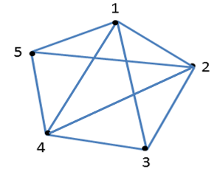
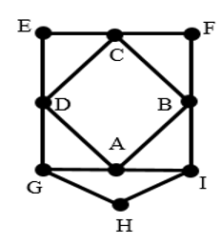
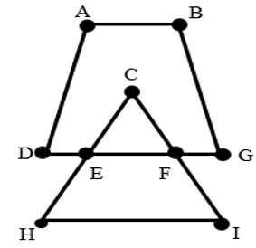
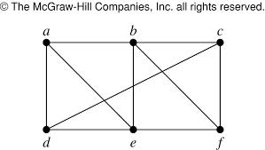
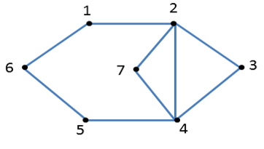
EXERCISE 5
1. Determine whether the following graphs are Euler path or Euler circuit. Construct the Euler path or Euler circuit if it exists.
a) b) c)
d) e)

Slide 42
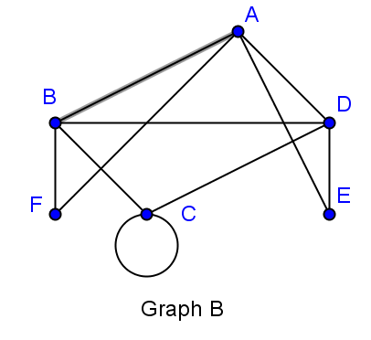
EXERCISE 5
2. Determine whether the following graphs are Hamilton circuit. If no Hamilton circuit, then determine whether it is Hamilton path. Construct the circuit or path if it exists.
a) b)
c) d)

